Slide 1



Data Mining – Sofa Score
Scraping soccer data by Daniel and Sagi

Slide 2
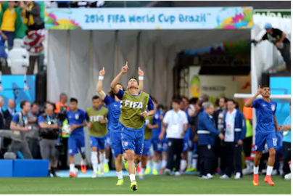
Entering The Field
Website and Scraping
Designing the Database
Enriching the Database
Visualizing insights
From ideal to real

Slide 3
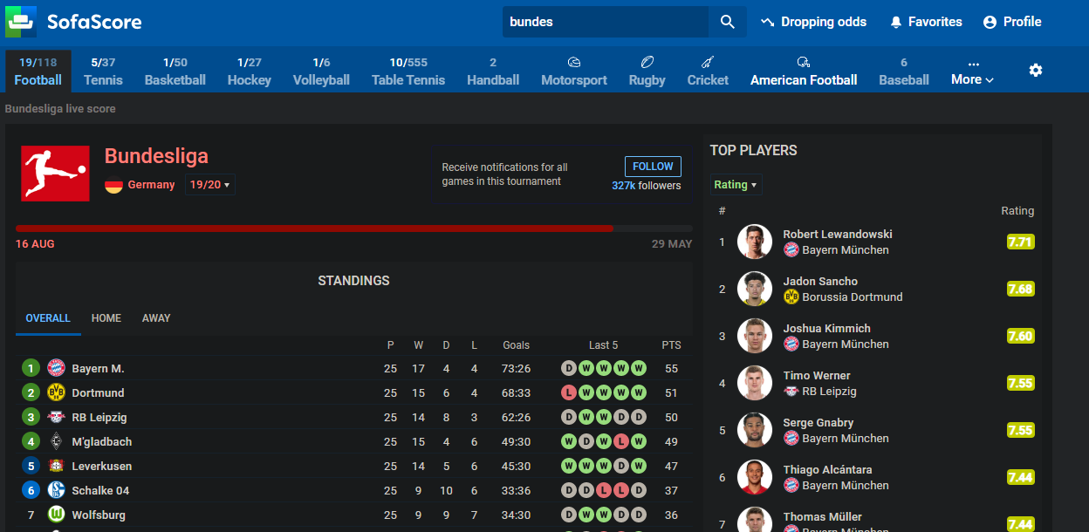
Website and Scraping
Leagues data:
Scraped data out of the 4 big leagues
Got the team URL's

Slide 4
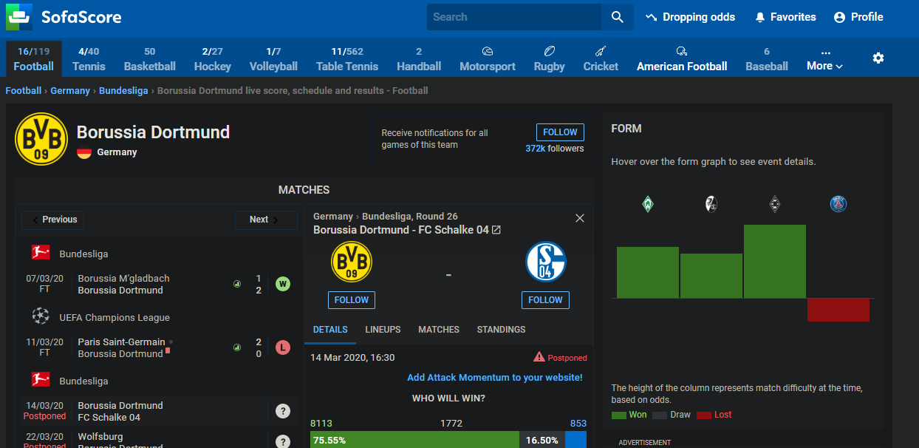
Website and Scraping
Teams data:
Scraped data out of the 4 big leagues
Got the players URL's

Slide 5
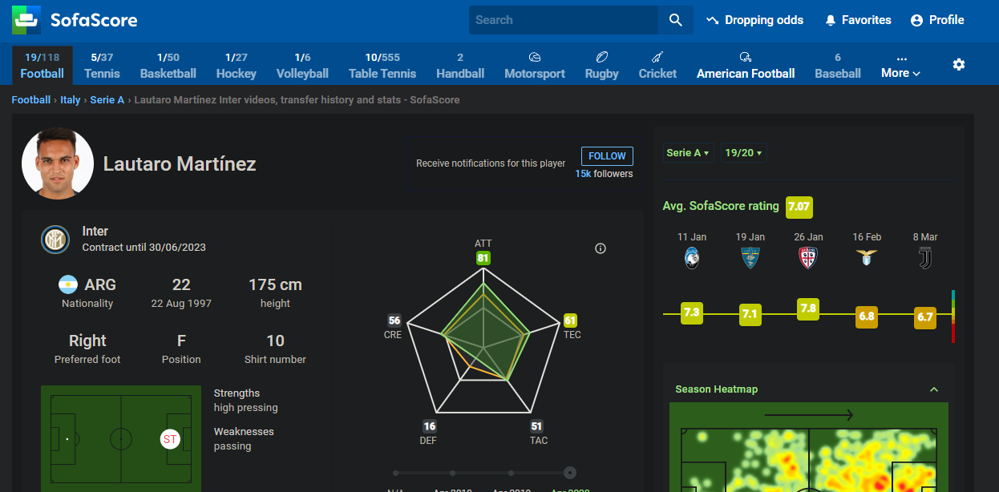
Website and Scraping
Players data:
Scraped 2200 soccer players pages
Basic information: name, birth-date, height, etc..

Slide 6
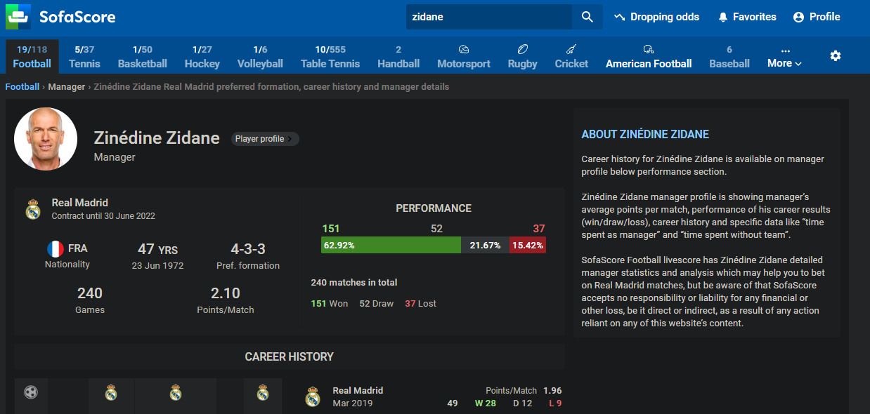
Website and Scraping
Managers data:
Scraped 78 managers, as there is one per team
Basic information: name, birth-date, formation, etc..

Slide 7
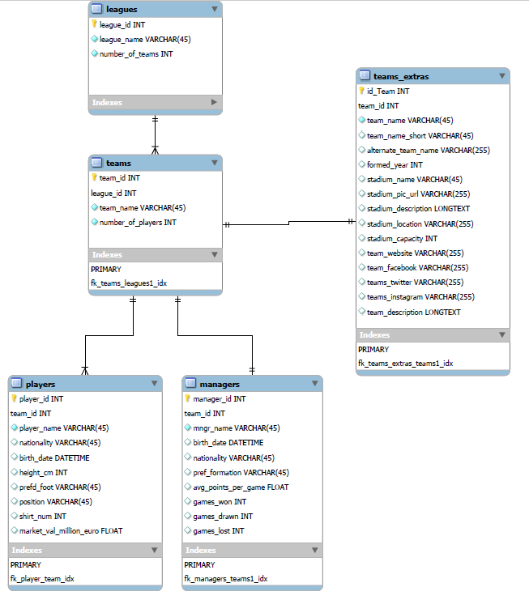
Designing the Database
Created 5 tables
Tried to mimic real life structure
Stored data about: - leagues
- teams (sofa-score and an external API)
- players
- managers
Stored several types of data – INT, REAL, DATETIME, VARCHAR, LONGTEXT
Used auto-increment for the keys
Used foreign keys to have a connection between the tables

Slide 8
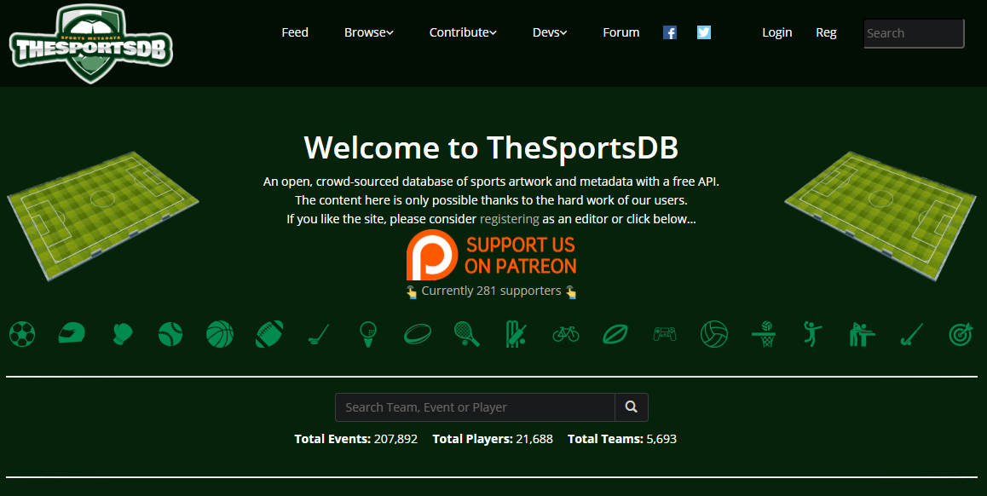
Enriching the Database
Used the free API – thesportsdb.com
We decided to enrich the data about the team
Created the table – “teams_extras”
Got additional information about the team stadium, team foundation year, etc…
Got a JSON text using the team name in the URL

Slide 9
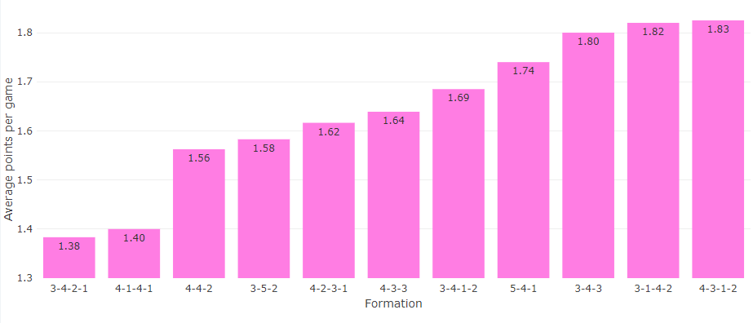
Visualizing insights
Grouped by all preferred formations and compared the average point per game

Slide 10
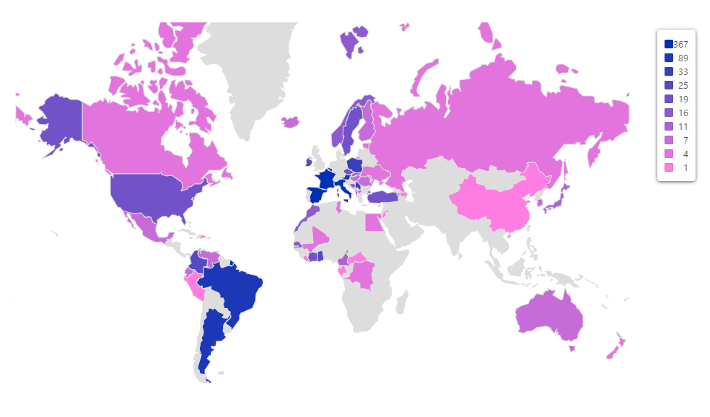
Visualizing insights
Count of players by nationality

Slide 11
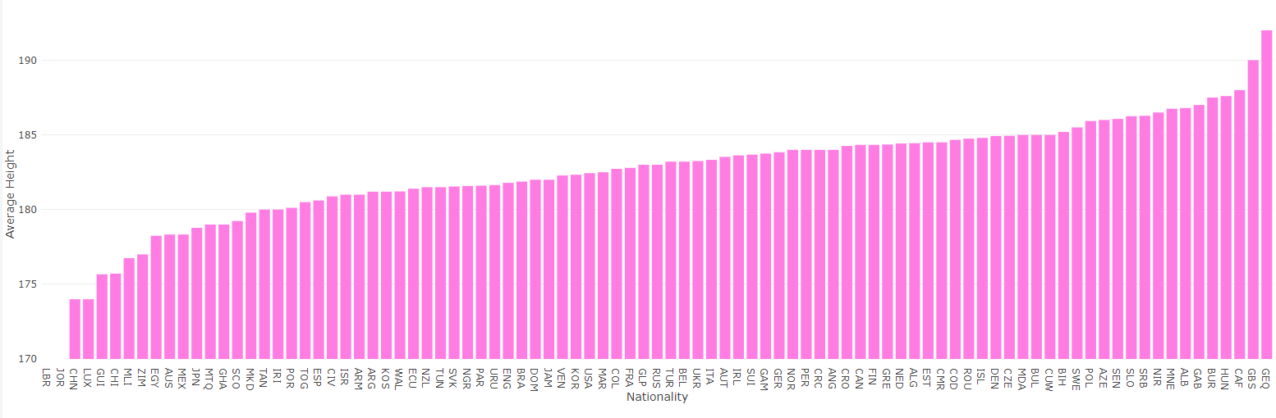
Visualizing insights
Height by nationality

Slide 12
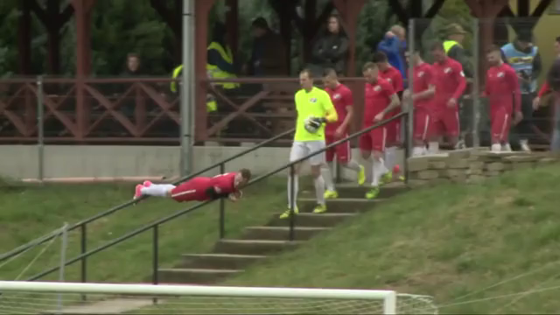

From Ideal To Real
Problem encountered:
The site changed on the go (3 times (till now!!!))
Special characters to be encoded
Differences in team names when calling external API
Chromedriver obviously

Slide 13

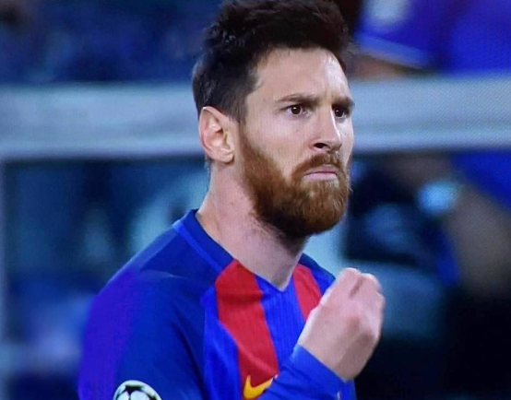
Questions
Thank You!

